Slide 1
Revision Questions
Applied AI – 2025/26

Slide 2
Question 1
The AI winter refers to a period of increased funding and heightened interest in artificial intelligence research.
True
False

Slide 3
Question 2
Alpha-beta pruning reduces the number of nodes evaluated in the minimax algorithm without affecting the final result.
True
False

Slide 4
Question 3
In computer vision, image segmentation involves dividing an image into meaningful segments for easier analysis.
True
False

Slide 5
Question 4
The first-order logic expression ∀x ∃y (Friend(y, x)) translates to "Everyone has a friend.
True
False

Slide 6
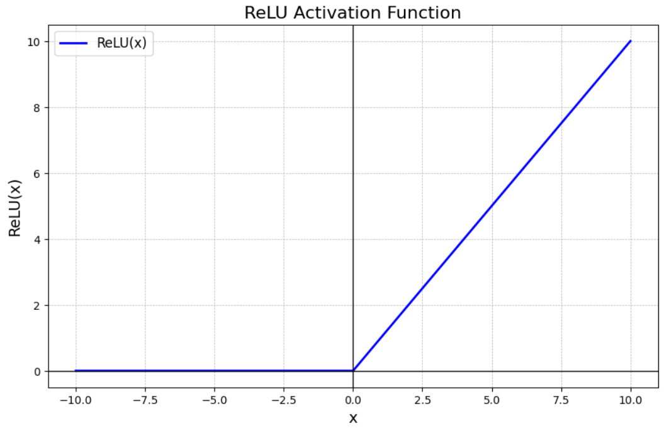
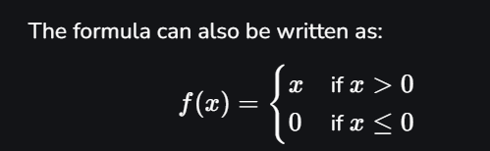
Question 5
The purpose of adding a RELU activation function in a CNN is to reduce the spatial dimensions (height and width) of the input feature maps.
True
False
https://www.geeksforgeeks.org/deep-learning/relu-activation-function-in-deep-learning/

Slide 7
Question 6
Large Language Models like GPT-4 are trained using supervised learning on labeled datasets.
True
False

Slide 8
Question 7
A simple reflex agent cannot form world models through its interactions in the environment.
True
False

Slide 9
Question 8
A simple reflex agent cannot form world models through its interactions in the environment.
True
False

Slide 10
Question 9
The minimax algorithm is only applicable to two-player, zero-sum games.
True
False

Slide 11
Question 10
Depth_first_search implements stack operation(LIFO) for the purpose of searching the states?
True
False

Slide 12
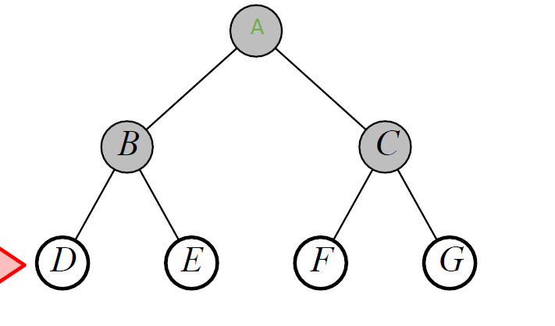
Question 10
Depth First Search > LIFO Put Sucessors at the Front > Stack
Breath First Search > FIFO Put Sucessors at the End > Queue

Slide 13
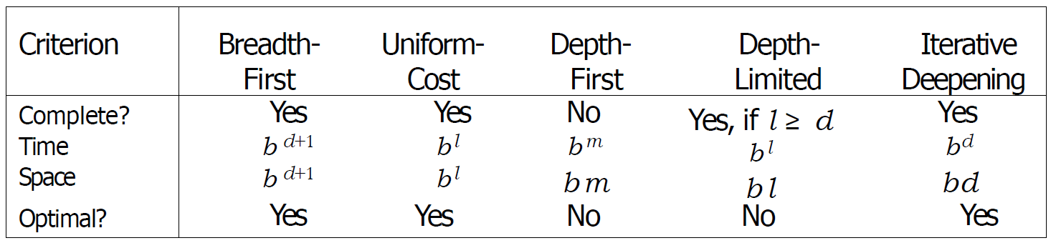
Question 11
Given b stands for branching factor, and d stands for depth. Which of the following search algorithms have complexity Time: O( b^{d}) Space:O( bd)
Depth First search and Iterative Deepening
Breadth first search
Breadth first search and Depth first search
None, all search algorithms are exponential in time and space complexity

Slide 14
Question 12
In GANs, the Generator's performance is improved based on feedback from:
Predefined heuristics
User interactions and inputs
An external labeled dataset
The Discriminator

Slide 15
Question 13
Which of the following statements about the k-means algorithm is TRUE?
The initial placement of centroids can affect the final clustering outcome
The number of clusters k does not need to be specified beforehand
K-means always finds the global optimum clustering solution.
K-means can naturally handle categorical data without preprocessing.

Slide 16
Question 14
In Linear Regression, the 'line of best fit' is determined by minimizing:
The correlation coefficient
mean squared error
The cross-validation error
The binary cross-entropy

Slide 17
Question 15
If a neural network has an input layer with 10 neurons, one hidden layer with 30 neurons, and an output layer with 5 neurons, how many weights are there in the network (assuming full connectivity between layers)?
45
1500
300
450

Slide 18
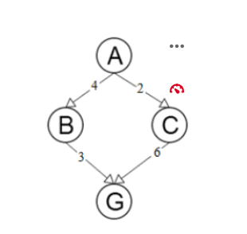
Question 16
Consider the following diagram where A is the start node and G is the goal node. The edges show the actual distance from each node to the next.
You are tasked to create an admissible heuristic for the A* algorithm. If h(A), h(B) and h(C) are the estimated cost to reach goal G from A, B and C respectively, which of the following h-values for A, B and C are admissible?
h(A) = 2, h(B) = 2, h(C) = 7
h(A) = 6, h(B) = 4, h(C) = 3
h(A) = 7, h(B) = 2, h(C) = 5
h(A) = 4, h(B) = 4, h(C) = 5

Slide 19

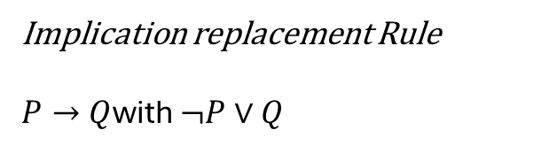
Question 17
The CNF (Clausal) form of A->(B ^C) is
Implication replacement Rule
$P→Q$with $¬P∨Q$
Given
A→(B∧C)
Remove Implication
¬A∨(B∧C)
Expand
(¬A∨B)∧(¬A∨C)
➔ This is the CNF Form

Slide 20
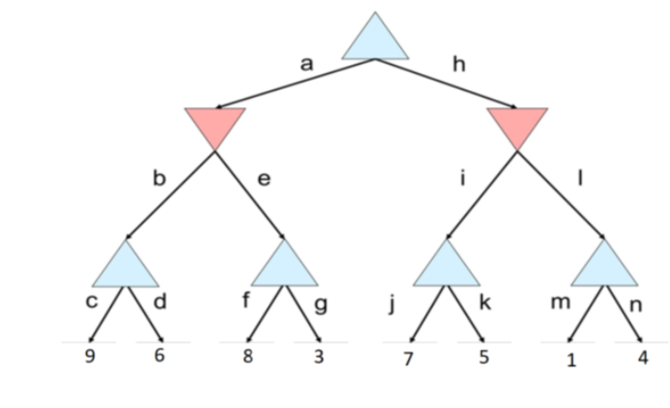
Question 19
In the following game tree, assuming the top node is a maximizing node and the red triangles are minimizing nodes, identify the optimal path that would be chosen by the Minimax algorithm.
a-e-f
a-b-c
h-l-n
h-i-j

Slide 21

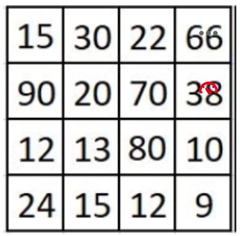
Question 20
Which option below is the result of 2x2 Average-Pooling on the following feature map ?

Slide 22
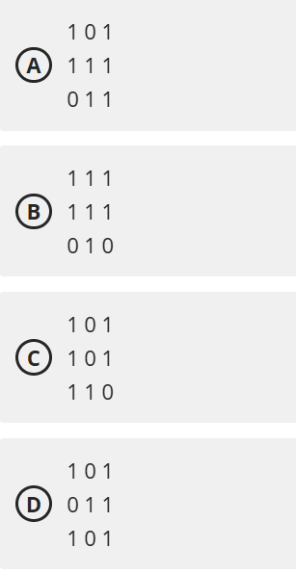
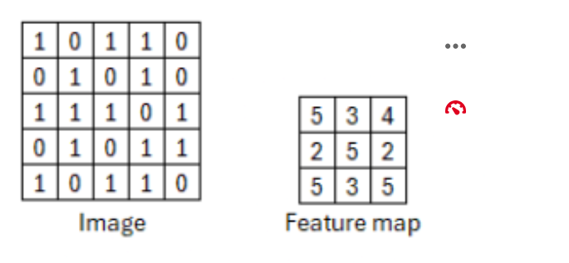
Question 21
Which of the filters, when applied to the given image using the convolution operation, will result in the provided feature map? Assume a stride of 1 and no padding.

